Slide 1
Android UI design
Jilin University

Slide 2
Main work--Sunhaotai
1、data collection
2、Model training and testing
3、paper

Slide 3
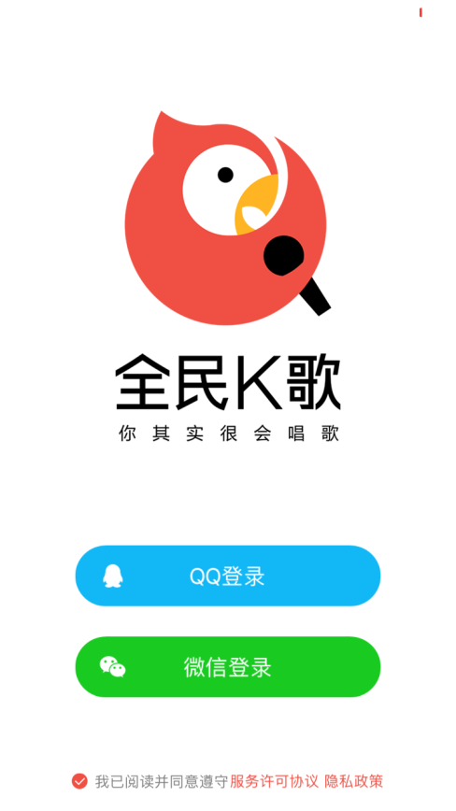

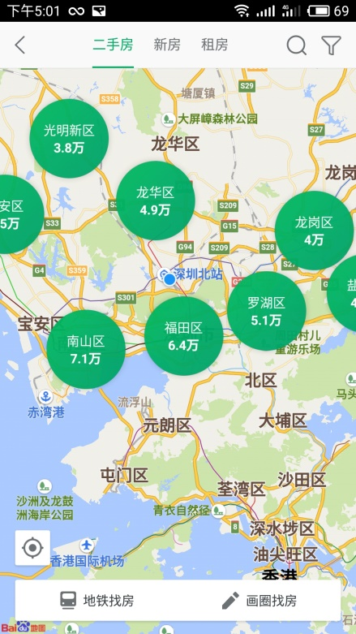
data collection
Work progress last week ：
（1）collection UI-web spider

Slide 4
Model training and testing
Work progress last week ：
Problem: focus on accuracy
（1）Add the convolution layer of the existing model
（2）Change the model
（3）Improve picture quality

Slide 5
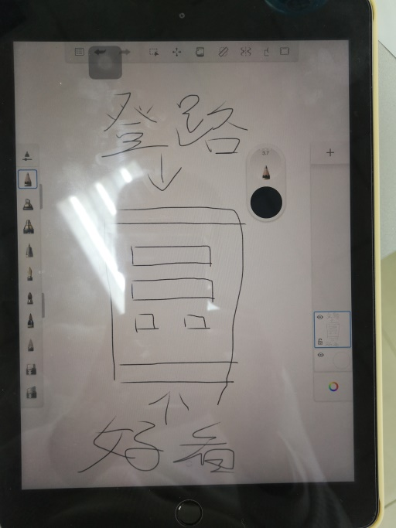
paper
1. Understand the sketch
2. Try to draw a UI login interface
3. read the paper

Slide 6
Reporting on work-jaingxue
1. Image feature extraction using histagram
The UI of APPs such as bilibili, keep and ofo are classified by hierarchical clustering and K-means clustering respectively.
2. Finalize the picture classification rules

Slide 7
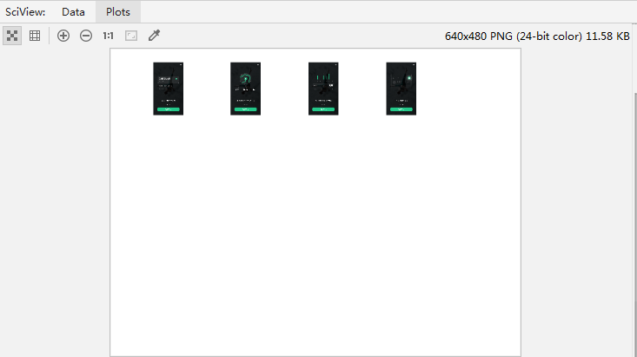
Hierarchical clustering results

Slide 8
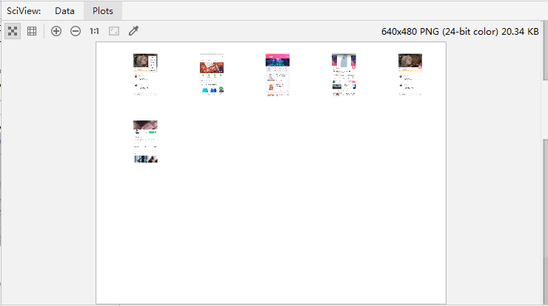

Slide 9
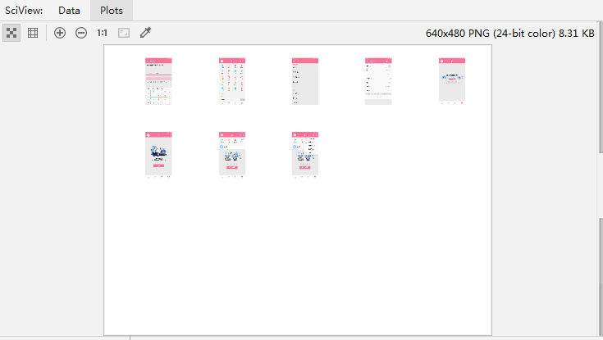

Slide 10
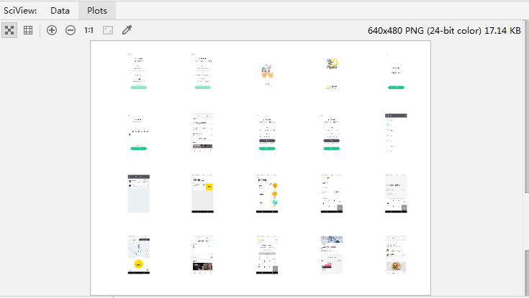

Slide 11
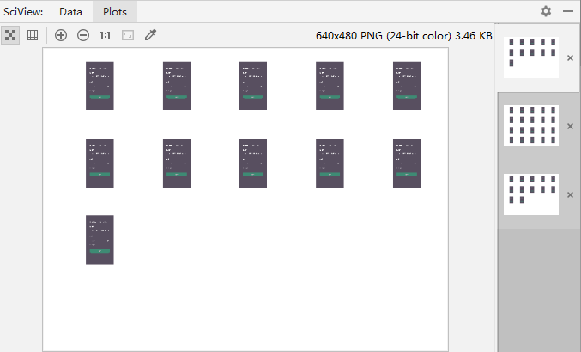
K-means clustering results

Slide 12
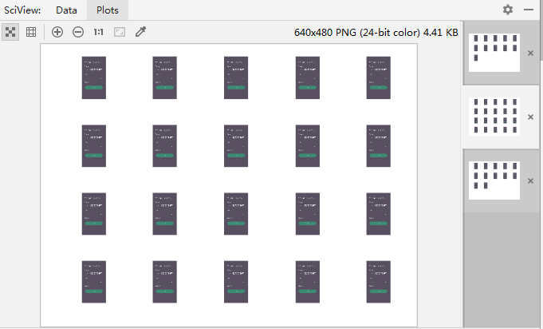

Slide 13
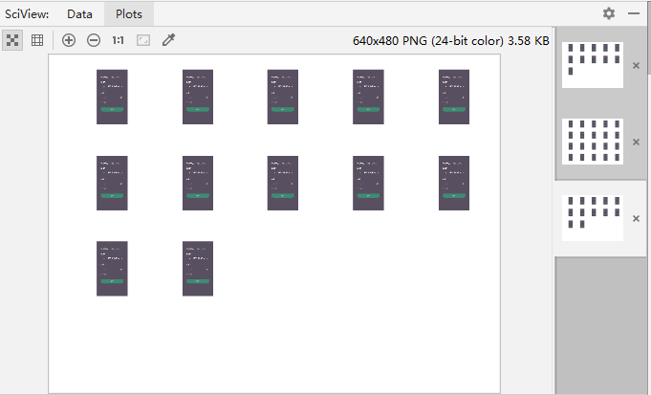

Slide 14
Image refinement rules
1.disigners incorrectly use the Scrolling Tab control for primary navigation
2.the slelected tabs are overshadowed by the visual emphasis on the action buttons
3.too many tabs but no labels
4.drawer at the bottom of the screen conflicts with the IOS 7 Control Center

